Slide 1
Backend
Pravin Y Pawar

Slide 2
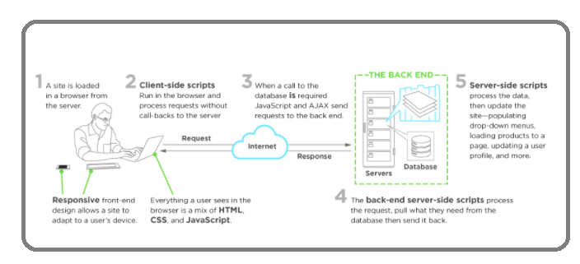
Server side
Interaction between front-end and back-end
To understand server side, one need to know the front end and how the two interact
Image : Upwork

Slide 3
Server side
Interaction Explained
The front end is what happens in the browser—everything the end users see and interact with
The back end, on the other hand, happens on the server
on site, or in the cloud
databases
Machinery that works behind the scenes—everything the end user doesn’t see or directly interact with, but that powers what’s happening!
Server-side manages all those requests that come from users’ clicks
Front-end scripts sends those requests over to the server side to be processed, returning the appropriate data to the front end
Often happens in a constant loop of requests and responses to the server

Slide 4
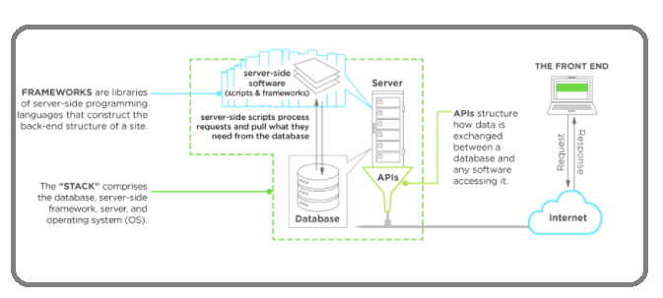
Server side architecture
Components
Server (web / application server)
Database
Operating System
API
Image : Upwork

Slide 5
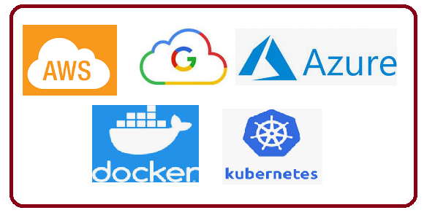
Server side architecture
Components
The “traditional” back end was simple
Mix of the server, databases, APIs, and operating systems that power an app’s front end
The back end of applications can look very different from application to application based upon
frameworks
cloud-based servers
containerization with a service like Docker
Backend-as-a-Service (BaaS) providers
APIs to replace more complex processing

Slide 6
Thank You!
In our next session:

